Slide 1
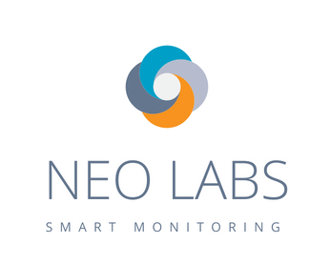


Multimodal camera-based human activity monitoring Independent Work Supervisor: Dr TIAN Jing
Team Name: Neo | EBAC4 (Part-Time) | 13/06/2018
Anusuya Manickavasagam - A0163300Y, Muni Ranjan - A0163382E Pradeep Kumar - A0163453H, Kesavan Sridhar – A0163207M
1
Notes:
Good morning everyone, thank you for attending the presentation. Before we start on behalf of all the team members, Anu, Muni, Pradeep (myself), and Sridhar. I thank Dr tian jing for sharing his expertise on Video analytics with us and continuously guiding and reviewing our work.

Slide 2
AGENDA
Objective
Approach
High Level System Diagram
Server / Front end development
Video Analysis
Demo
Current Challenges
Future Plan
2
Notes:
Here is the agenda for today. I will first share with the you the Use cases we want to handle, the objectives for phase1 and the overall progress on system we took followed by the live demo plus some use cases videos.

Slide 3
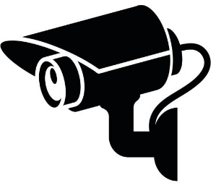


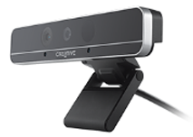
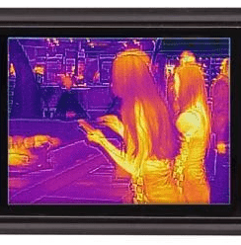
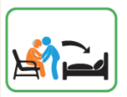
OVERALL OBJECTIVES
CCTV camera
Depth camera
Server (desktop)
Movement profile (sleep, active, sit, etc)
Abnormal movement detection (fall down)
Surveillance management dashboard
Alert terminal (phone or tablet)
Display message notification, snapshot or short video clip
Display live video streaming
Thermal camera
An use case in eldercare
3
Notes:
This is the overall objective of this system.
We want to capture different streams from sensors, camera etc. and want to monitor the movement profile of the subject.
Subject could be a aged person in elder care, patient in the hospital or kids at home. We can learn and provide useful and actionable alerts to administrator in these cases.

Slide 4
PHASE 1 USE CASES
Research and finalize the purchase of camera
Setup the Camera with mini processor
RGB video analytics to find if person is active or inactive
Raise an alert if person is inactive in daytime or active in night time
Upload the clip to server and stream on dashboard
SMS the alert message to registered number
Dashboard showing the active/inactive live status and chart
4
Notes:
Here is the phase 1 use cases. We studied the project form inception and wanted to setup a intel realsense depth camera. Following agile methods, for phase 1, we focused on overall infrastructure setup, streaming the RGB frames and analyzing and sending the data to server side application which pushes the data further to dashboard which is react based browser client.

Slide 5
High Level System Diagram
2
5

Slide 6
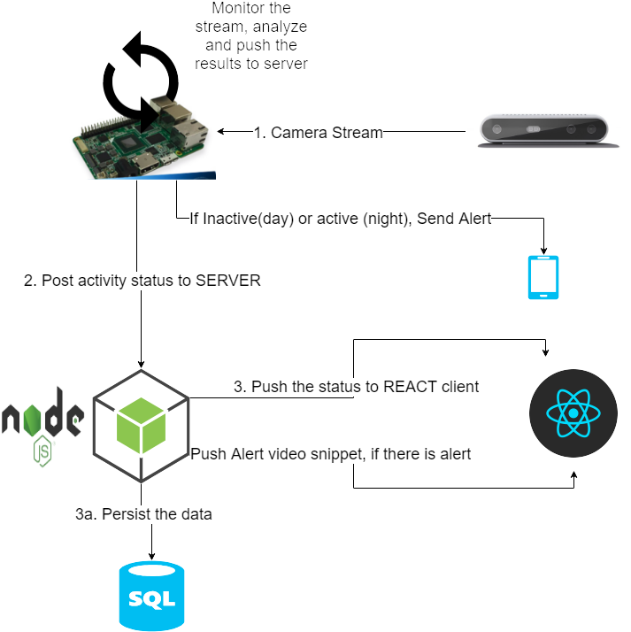
SYSTEM ARCHITECTURE
6

Slide 7
Front end development
3
7

Slide 8
Tools and process
Node JS was used for server backend to capture every second status and the video clip if there is alert
Database used for storing status is SQLite
React JS was used for building user interface and thus display in the dashboard real time status(active and inactive)
8

Slide 9
Video Analysis
4
9

Slide 10
HUMAN DETECTION AND TRACKING
Using Computer vision capabilities of opencv &python
Background subtraction
Detecting human using RGB Intel realsense camera stream
Using frame differencing method to detect if person is active or inactive
If he/she was active during night and inactive during the day then detect and send alert to user in form of video clips
Send active/inactive status to server and populate chart
10

Slide 11
Demo
5
11

Slide 12
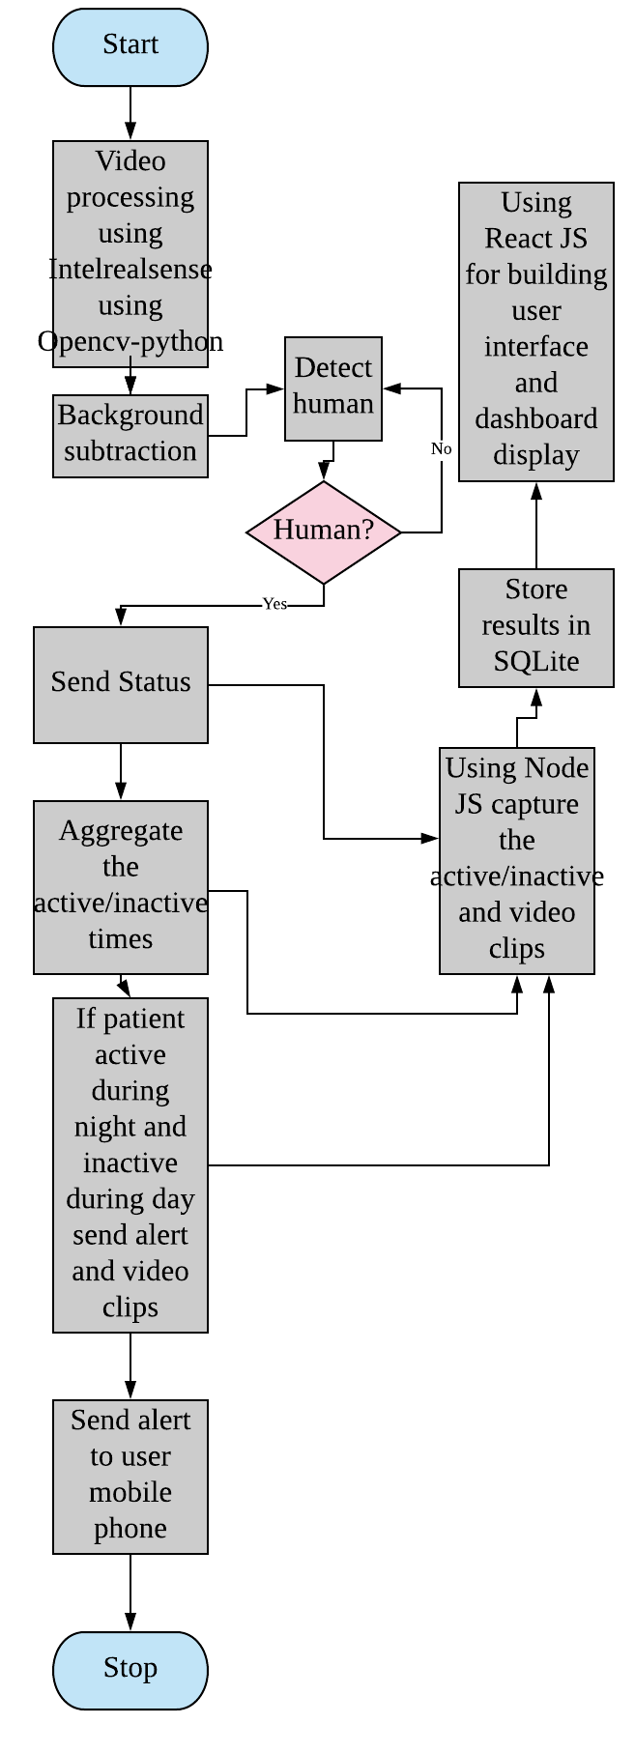
FLOW CHART
12

Slide 13
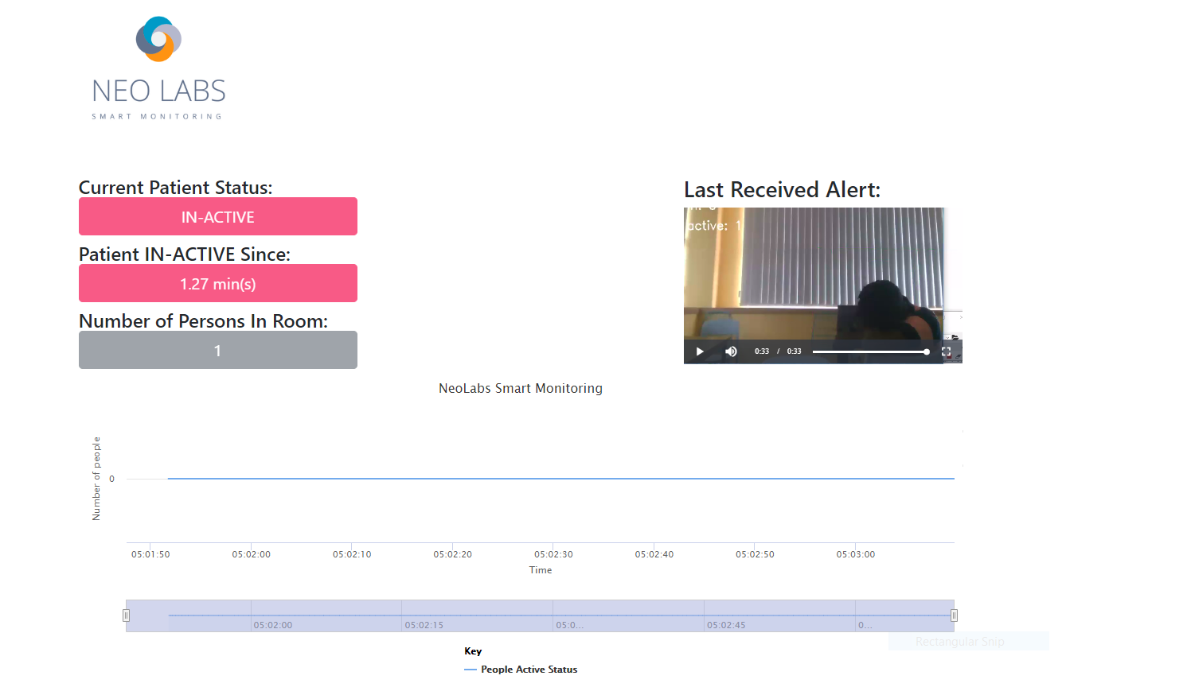
DASHBOARD
13

Slide 14
Challenges
6
14

Slide 15
CHALLENGES
Camera stream hangs in actual Intel Up board deployment
Defect opened with SDK
Setting up the Intel board
Too many combination on windows/linux
Human detection accuracy. False Positives is high
Current Algorithm detects on upper body
15

Slide 16
What’s Next
7
16

Slide 17
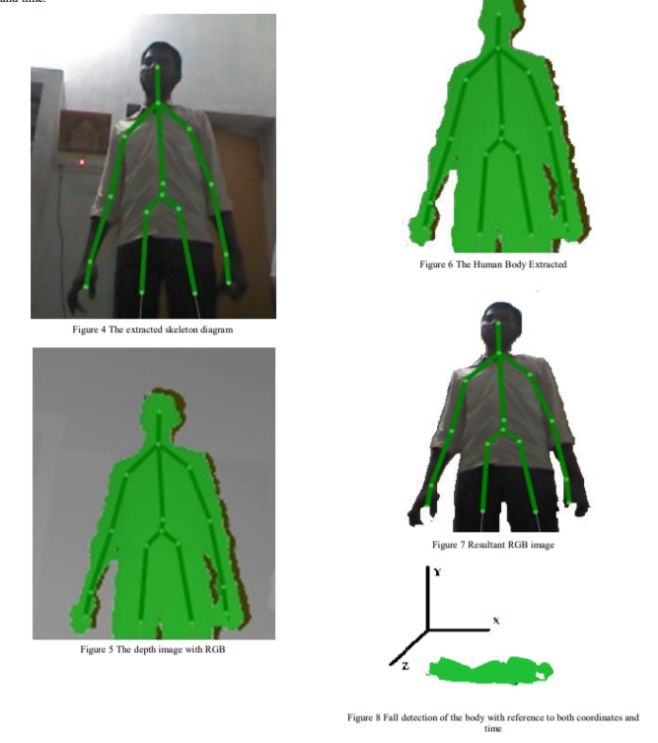
FALL DETECTION
17

Slide 18
WHAT’S NEXT
Defect Fixes (from intel SDK)
Movement profile (sleep, active, sit, etc)
Abnormal movement detection (fall down)
Surveillance management dashboard improvement
End to End Deployment
Depth camera analysis
18

Slide 19
Project Documentation
https://bitbucket.org/teamneo/videoanalytics
https://trello.com/#
https://docs.google.com
19

